Slide 1
99-353 SolidWorks and Laser Cutting
Working With Acrylic
Dave Touretzky Computer Science
Carnegie Mellon University

Slide 2
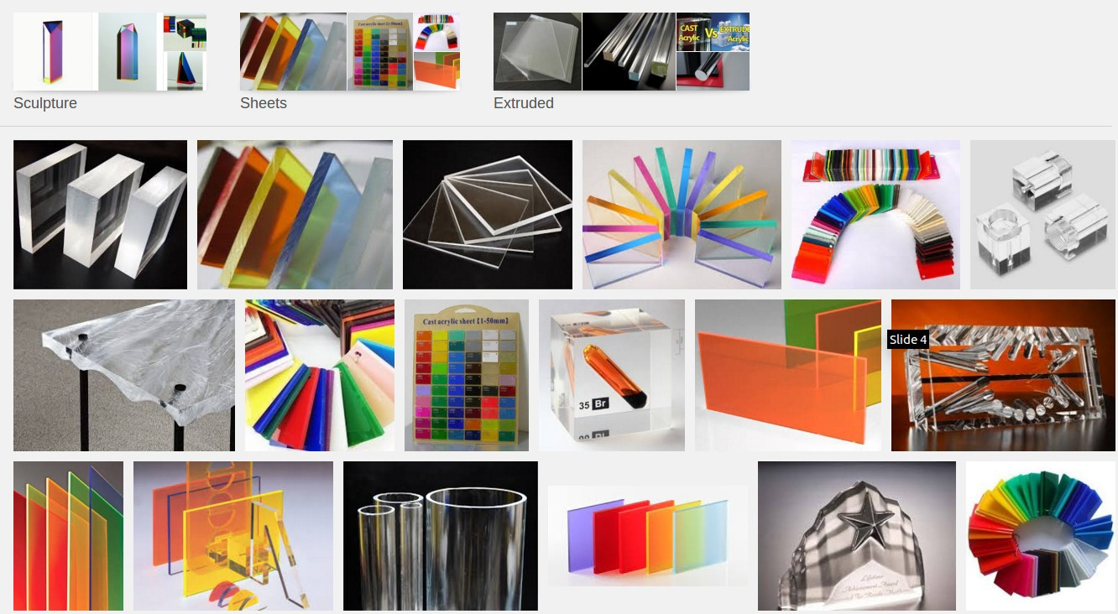
Acrylic Comes in Many Colors

Slide 3
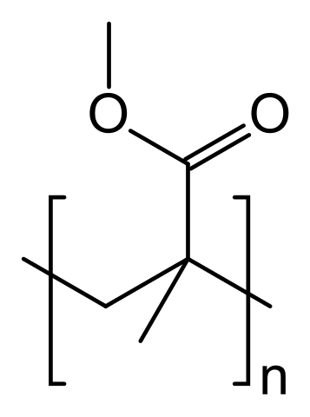
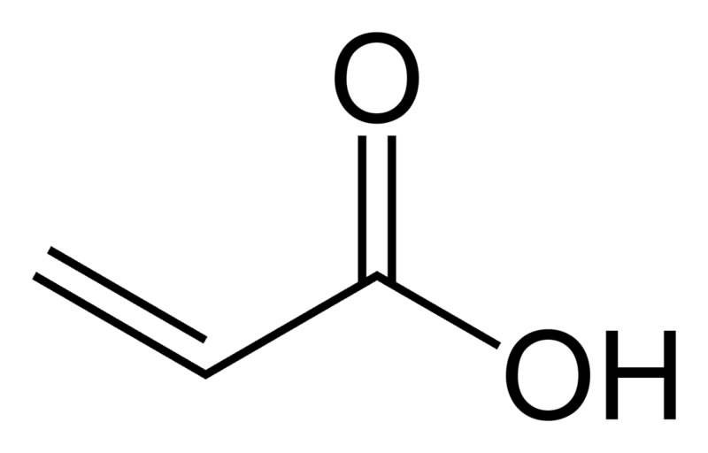
What Is Acrylic?
●
Polymer of acrylic acid:
poly (methyl methacrylate)
Acrylic acid
poly (methyl methacrylate)
●
Also known as Plexiglass, Lucite, Perspex...
Can be either cast or extruded. Cast is better for laser cutting; extruded is easier to thermoform.
●

Slide 4
Thickness Variance
We order 1/8 inch cast acrylic sheets. What we get:
Sometimes 0.125 inch sheets.
Sometimes 0.118 inch (3 mm) sheets.
Thickness tolerance +0.015 to -0.025 inches. Thickness can vary:
From one batch to another
From one edge of a sheet to the other edge!
Thickness matters for press fit.
●
●
●
●
●

Slide 5
Cutting Acrylic
●
For 1/8 inch acrylic use:
Speed 16 mm/sec
Power level 80%
●
For 1/4 inch acrylic use:
Speed 12 mm/sec
Power level 80%
●
If the laser is having problems and not cutting all the way through the sheet (could be a dirty lens or focusing problem), reduce the speed slightly.
5

Slide 6
Acrylic vs. Other Plastics
●
Acrylic is:
Colorful
Inexpensive
Fragile
●
Delrin is:
Black or tan only
More expensive
Stronger
●
ABS plastic:
Black/white/tan sheets only
Much stronger
Catches fire in the laser cutter!
6

Slide 7
Cut Residue
●
Sometimes parts are discolored due to:
Smoke/ash plume from the melting plastic.
Residue from the honeycomb bed re-melting and contaminating the part.
●
Wiping with isopropanol (rubbing alcohol) can clean up the part.
Acetone (nail polish remover) sometimes works better.
●

