Slide 1
99-353 SolidWorks and Laser Cutting
Kerf and Joinery
Dave Touretzky Computer Science
Carnegie Mellon University

Slide 2
Beam Width
The beam cuts by burning and melting. The width of the beam is non-negligible.
●
●

Slide 3
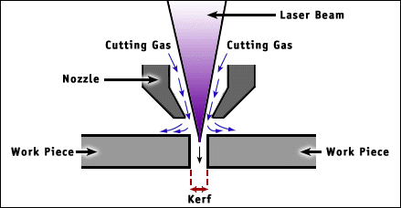
Kerf

Slide 4
Kerf
●
Typically 0.08 to 0.45 mm (3 to 18 thousands of an inch), depending on:
Laser optics and focusing
Type of material
Thickness of material
Consequences:
Parts will be undersize
Holes will be oversize
Example: 0.1 inch diameter holes in acrylic:
Measured diameter 0.106 inches (kerf 0.006”)
●
●
4

Slide 5
What does this mean when you are sizing the outer dimensions of a part? Sizing a hole?

Slide 6
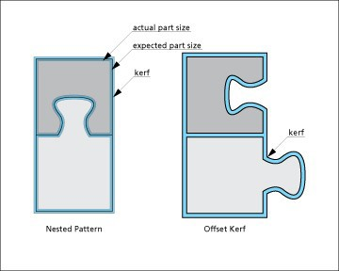
Offset Kerf
Can do this in SolidWorks with Insert > Faces > Move.

Slide 7
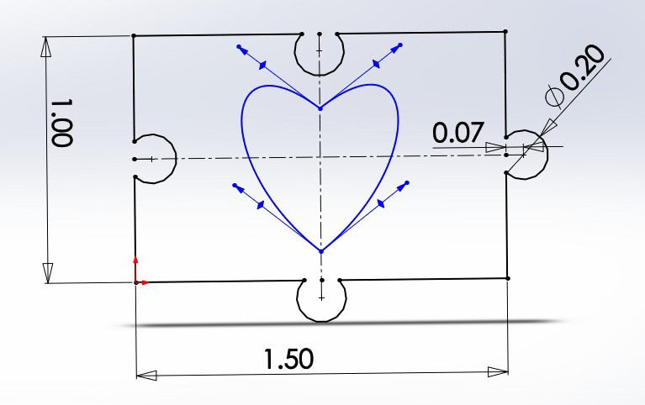
Kerf and Puzzle Pieces
No correction:

Slide 8
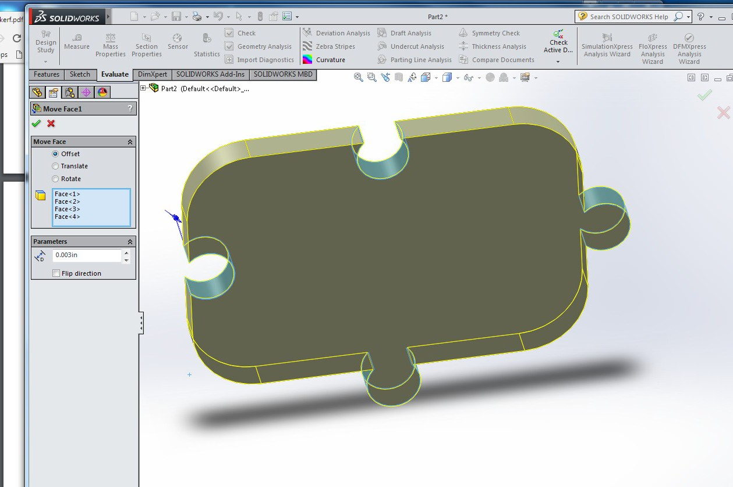
Faces > Insert > Move : Offset

Slide 9
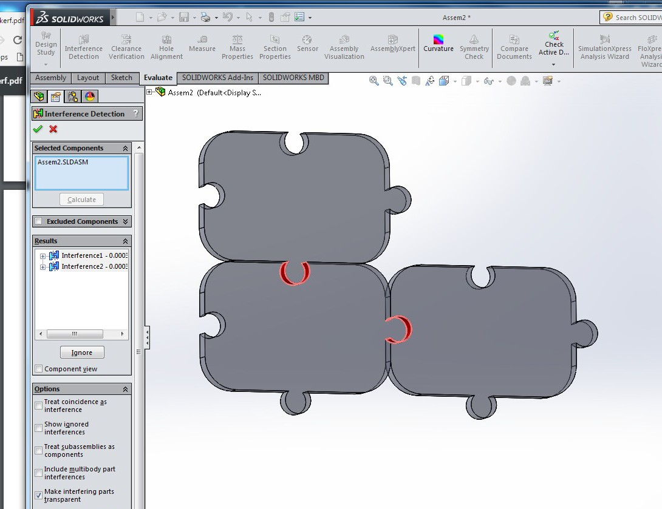
Intererence Shows the Offset

Slide 10
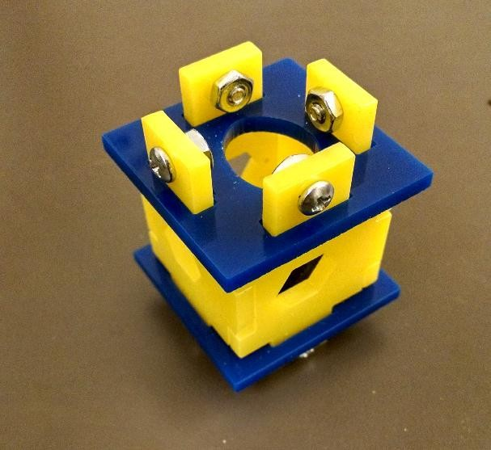
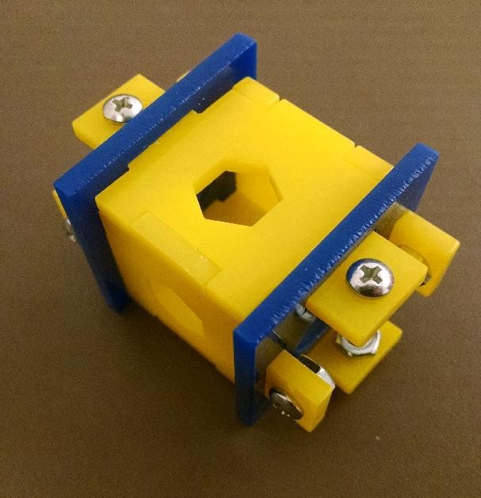
Making a Box
Tab and slot construction Fasteners through the tabs
●
●
10

Slide 11
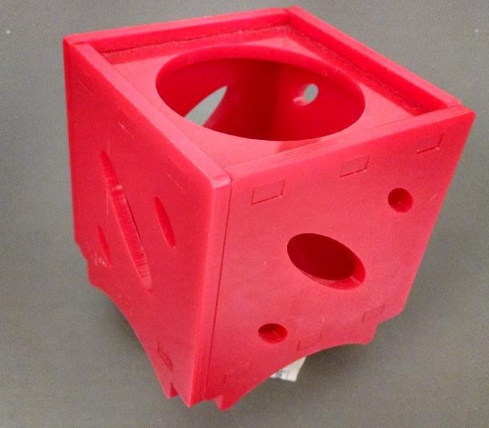
Making a Flush Box
Tabs are flush with the slots Fastened with acrylic cement
●
●
11

Slide 12
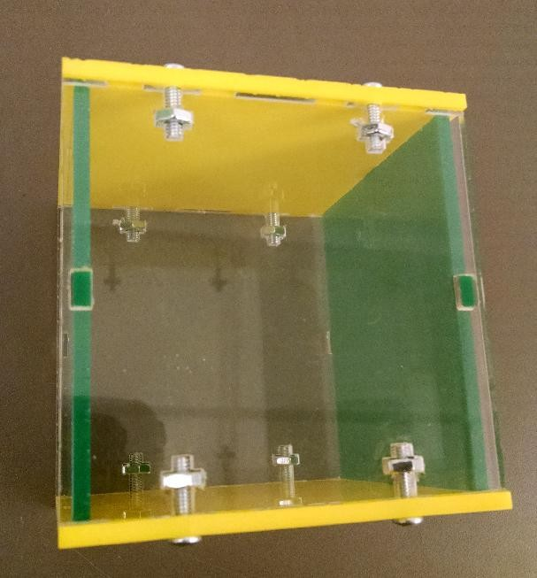
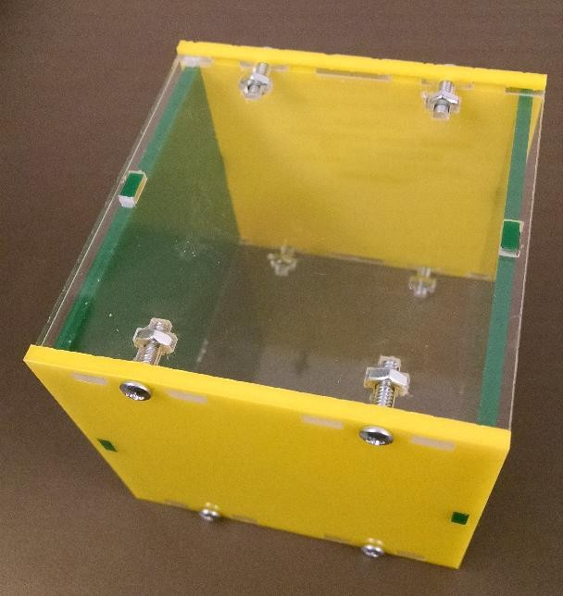
T-Slot Joints
Nut embedded in the panel Panels held under tension
●
●
12

Slide 13
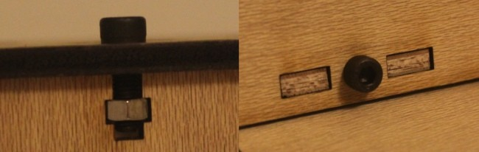
T-Slot in Wood
Image from Xiaoyang Kao xy-kao.com
13

Slide 14
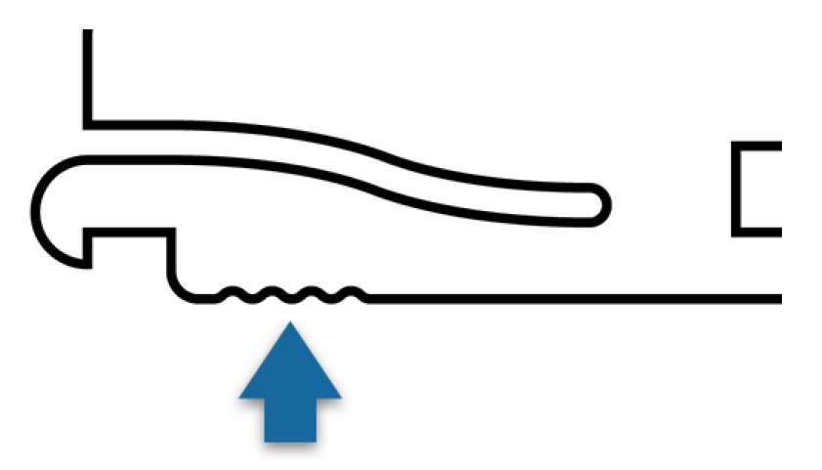
Dragon's Claw Joints
Image from Phil Burgess, Adafruit Industries.
14

Slide 15
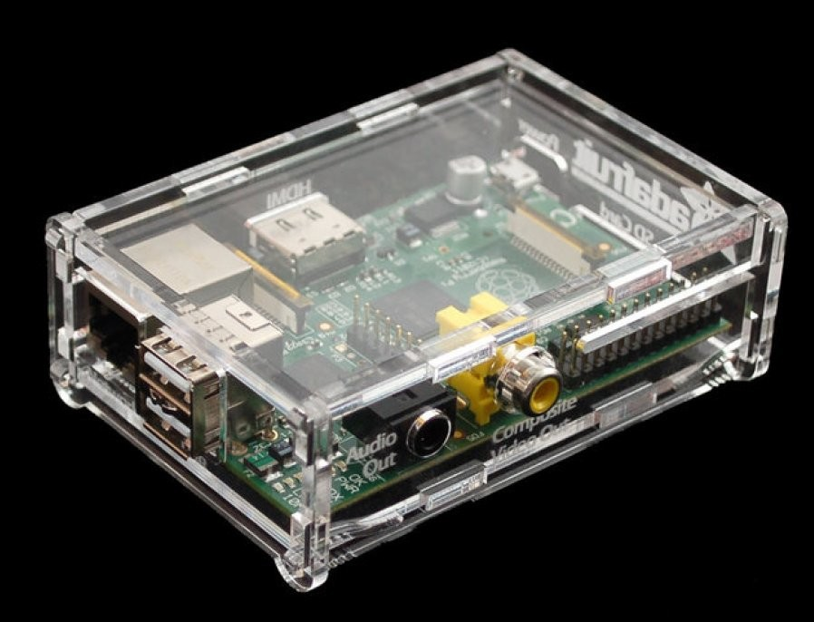
Dragon's Claw
Image from Phil Burgess, Adafruit Industries.

Slide 16
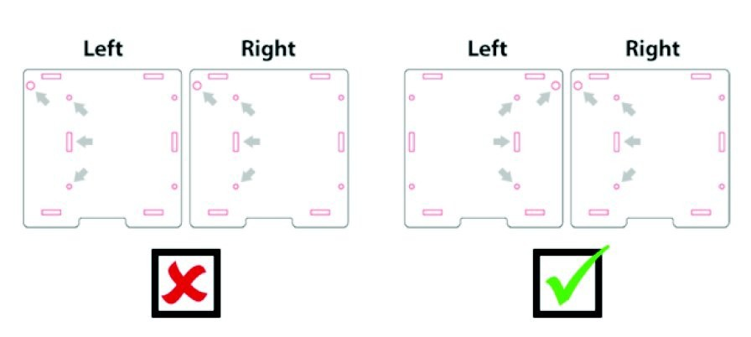
Mirror Matching Parts Instead of Copying Them
Compensates for laser cutter asymmetries: beveled edges due to depth of cut. Otherwise you get a skewed parallelogram instead of a box.
Image from Phil Burgess, Adafruit Industries.

Slide 17
Mirror to Counteract Skew
20

Slide 18
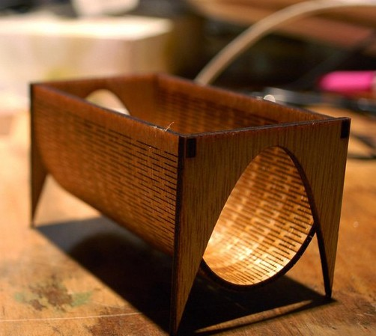
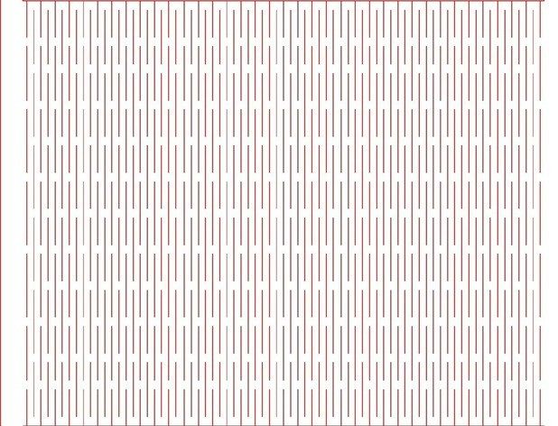
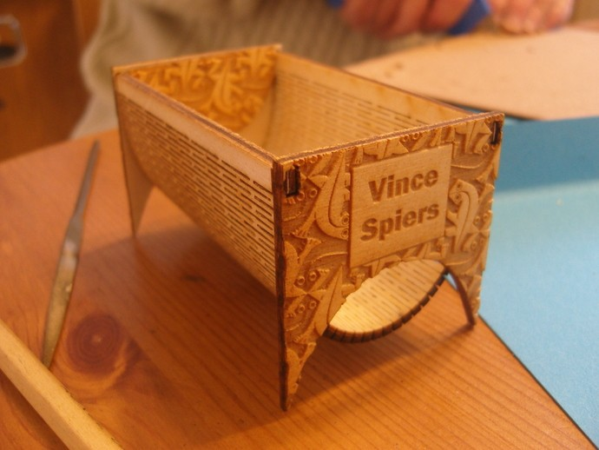
“Living Hinge” in Wood
21
http://www.thingiverse.com/thing:15845

Slide 19
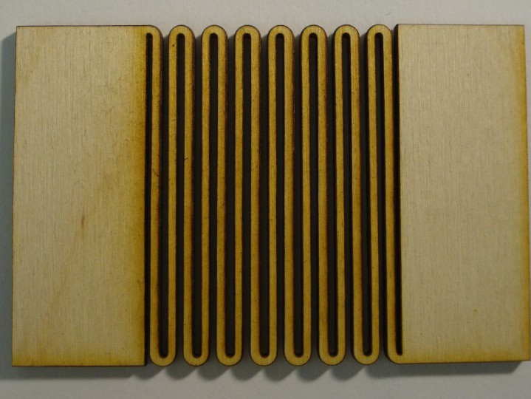
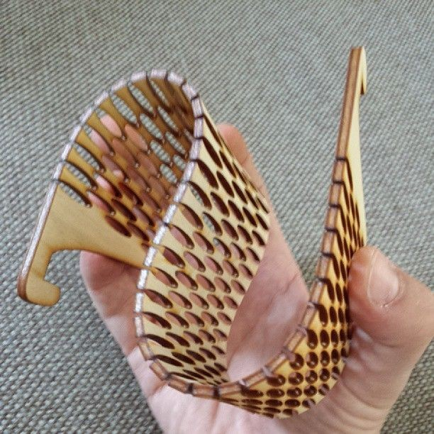
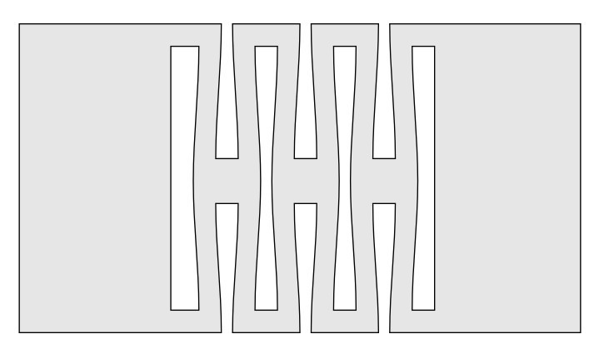
Living Hinges
2
2

Slide 20
Engraving
●
Engraving uses raster scan to fill in an enclosed contour.
●
Select “Engrave” instead of “Cut” in the laser client program.
●
To engrave acrylic, use these settings: speed 325 mm/sec, power 15%.
●
Higher power will cut deeper but can leave artifacts.
23

Slide 21
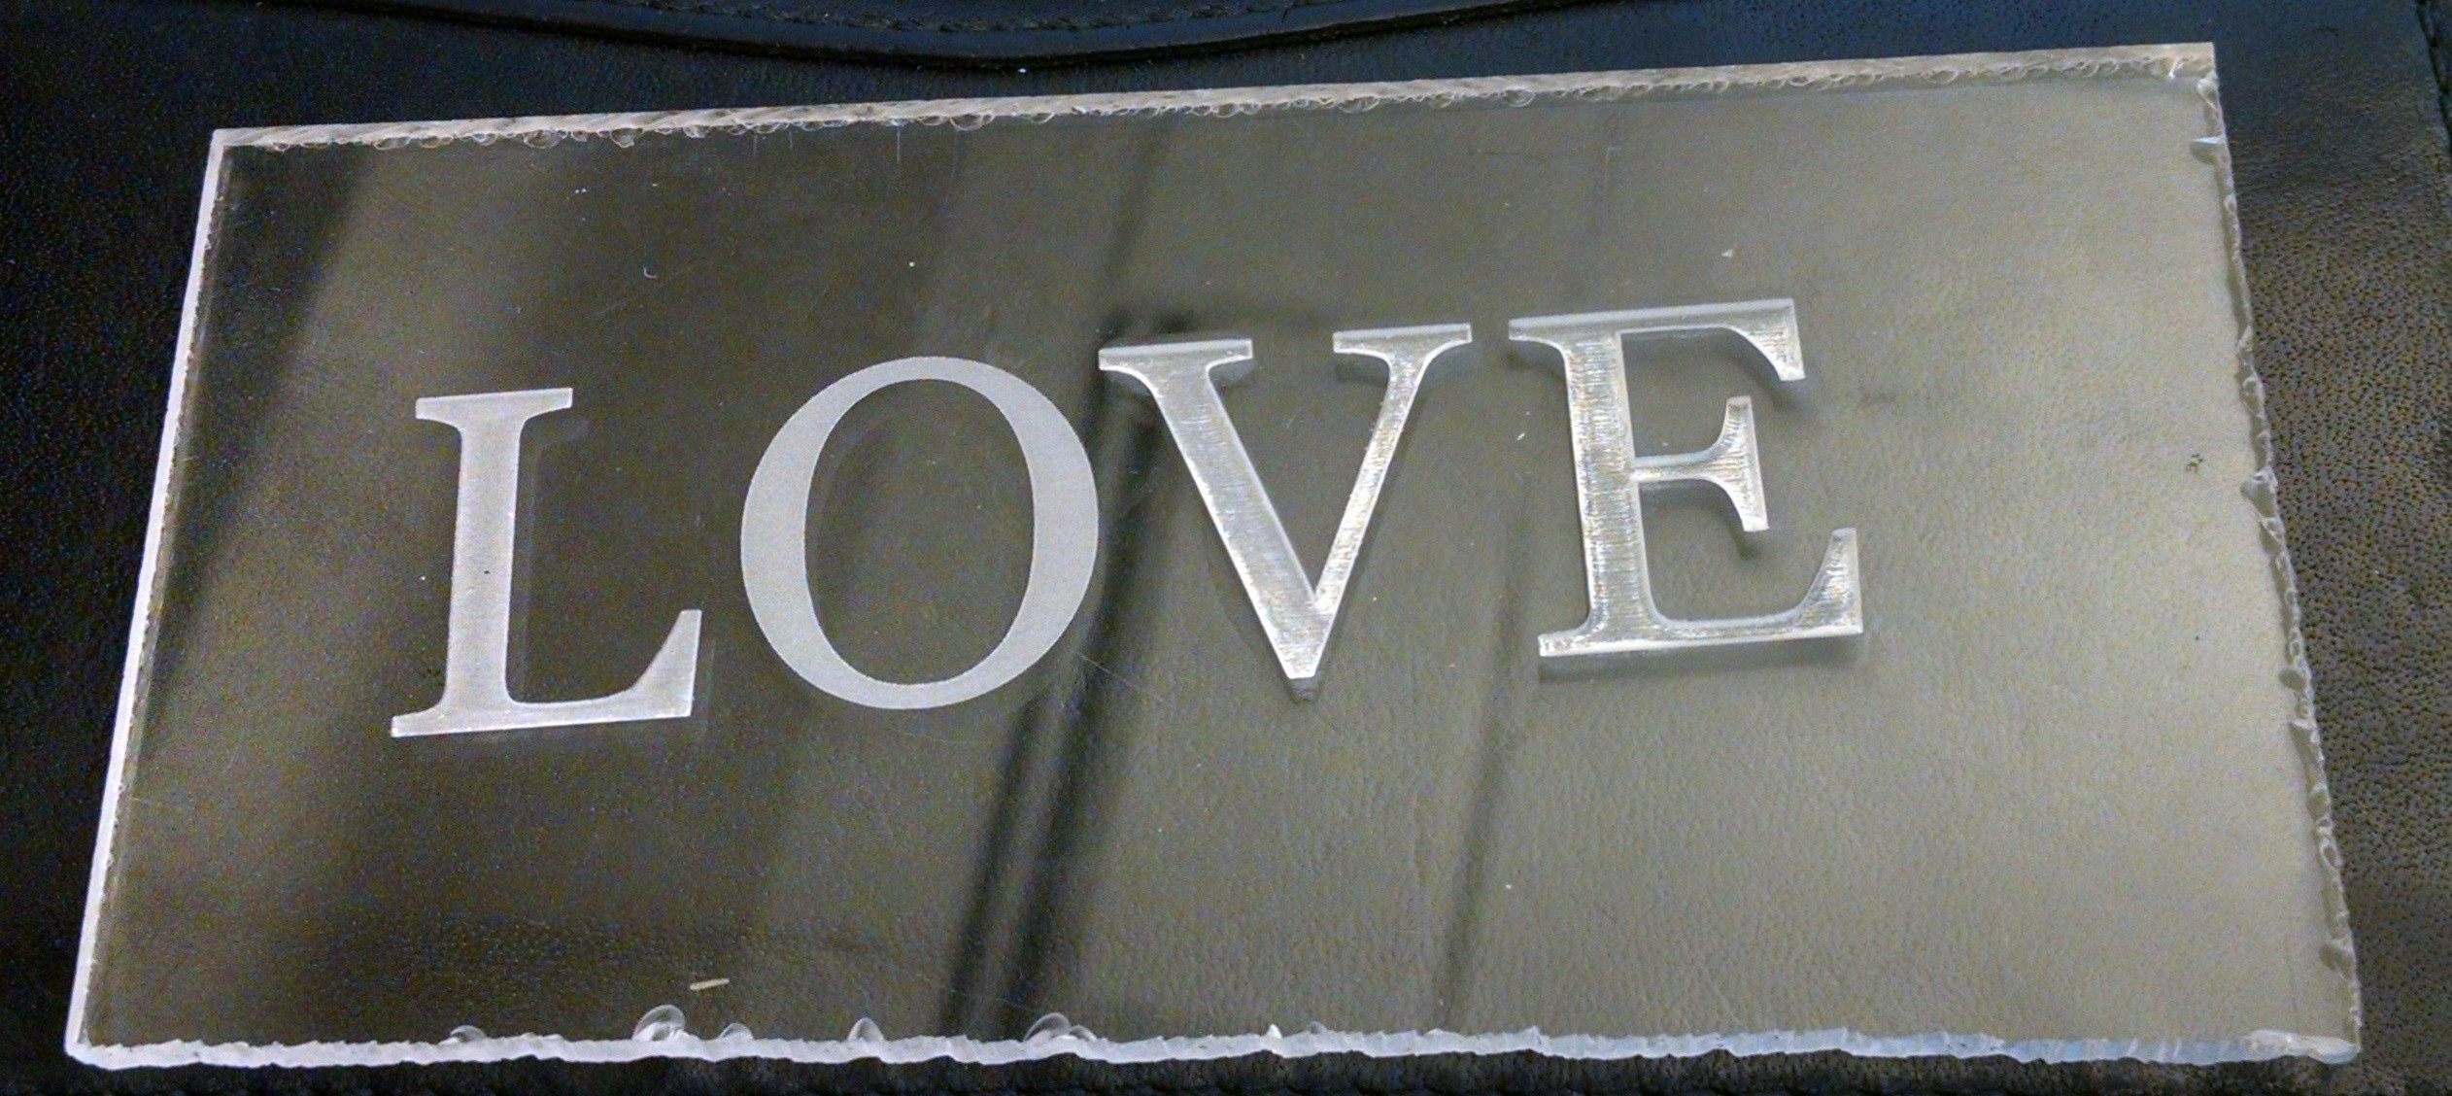
Engraving Acrylic
15%
power
60%
power
24

