Slide 1
Laser Cutter Intro
Susan Finger
Dave Touretzky
Carnegie Mellon University
1

Slide 2
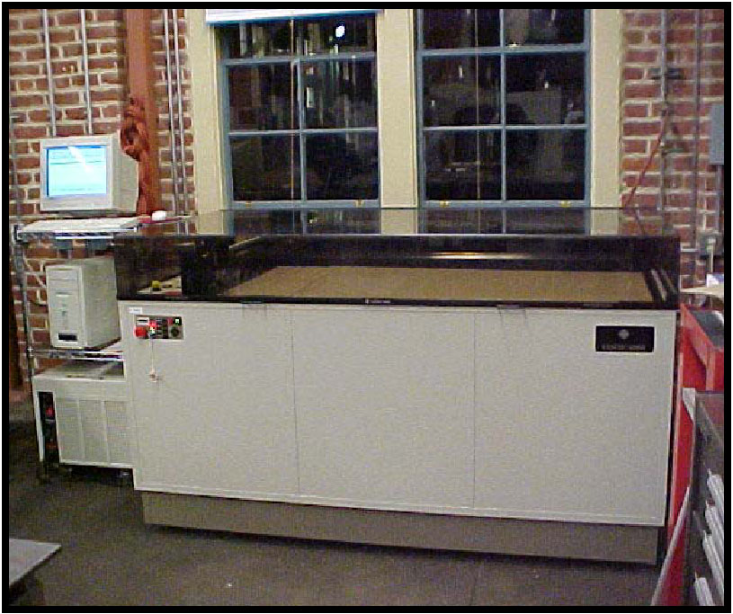
2d laser cutter
Based on pen plotters used in architecture studios which accept DXF files from CAD programs to produce 2D drawings
LaserCAMM (mid-1980s) replaced pen with a laser

Slide 3
From Design to Part
Part
Part
Parts
Colored DXF file
DXF file
Drawing
Part
SolidWorks
Inkscape DraftSight
Illustrator etc.
2

Slide 4
How a laser cutter works (1)
A laser produces a small, focused beam of energy
Material struck by a laser beam absorbs the energy; the amount of energy absorbed depends on the properties of the material and of the laser beam.
The properties of a CO2 laser, like the IDeATe laser cutter, are well matched to the material properties of plastic, wood, fabric, and paper.

Slide 5
How a laser cutter works (2)
A laser beam is directed at a horizontal sheet of material by a sequence of mirrors
The mirrors are driven by computer-controlled motors so that the laser beam can move in the x, y (along the plane of the bed) or z (vertical) direction. The speed of the laser beam is also computer controlled.
The speed and power of the laser can be varied so that the laser either cuts through or only etches the material.
The depth of the cut is controlled by the color of the lines in the dxf file.

Slide 6
Recap
The laser cutter is driven by a DXF file
A DXF file uses a line (vector) based format
=> We need a create vector-based file to make our part

Slide 7
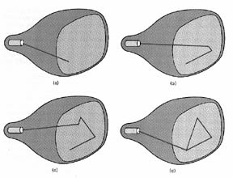
Raster versus Vector
Raster – scanned pixels
Vector – drawn lines
Why do TVs use raster technology?
Why do laser cutters use vector technology?

Slide 8
Bitmap (raster) graphics (not good for laser cutting)
Bitmap images contain information about the color of each pixel
Bitmap, raster, or pixel-oriented graphics programs
PhotoShop
MS Paint
Corel Painter
Bitmap graphic formats include GIF, JPEG, PNG, TIFF, XBM, BMP, and PCX.
Screen fonts are stored as bitmaps

Slide 9
Vector graphics (good for laser cutting)
Vector graphics contain objects with instructions about location, color and size of each object
Vector or object-oriented graphics programs
Adobe Illustrator
Corel Draw
Any CAD or GIS program (SolidWorks, AutoCAD, ProE, SketchUp, ArcGIS, …)
Vector graphic formats include PICT, EPS, WMF and PDF
TrueType fonts are stored as vector graphics

Slide 10
CAD Tools
●
The big two:
AutoCad from AutoDesk
SolidWorks from Dassault Systemes
Alibre/Invent Sketchup Blender
CorelDraw, Inkscape, Rhino
Sketch It Make It (developed at CMU) Many more...
●
●
●
●
●
●
10

Slide 11
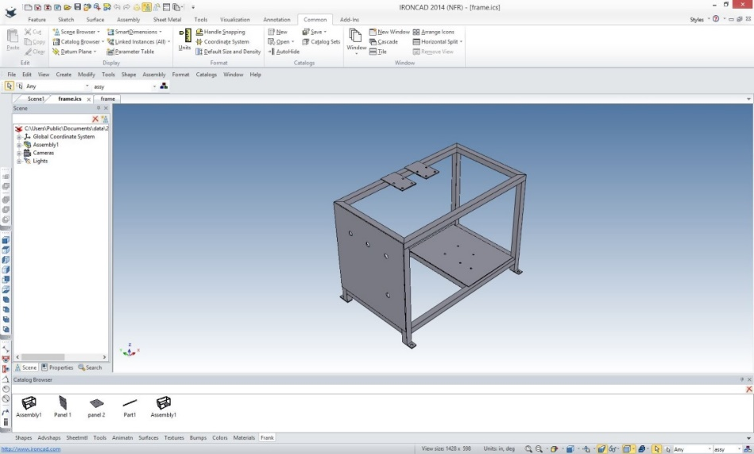
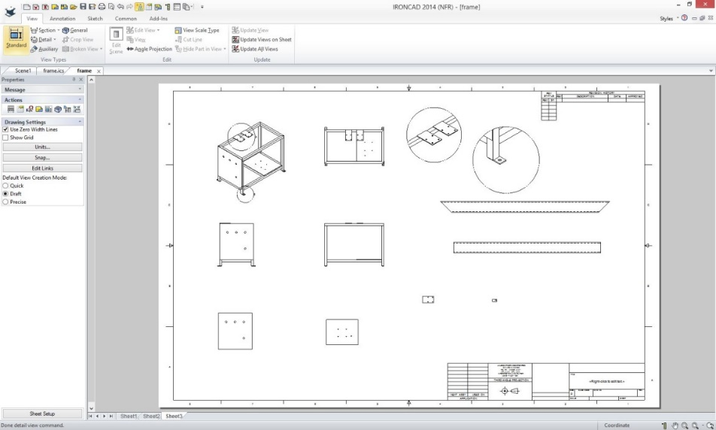
CAD drawings
AutoCAD Drawing Exchange Format (DXF), introduced in 1982, converts a CAD model of points and lines in 3D space into a 2D drawing
DXF enables the generation of line drawings (blueprints) from CAD models
http://tecnetinc.com/The Assembly Defined.html

Slide 12
Rabbit Laser RL-80-1290
80 watt CO2 laser
1200x900 mm bed Exhaust filter Chiller
●
●
●
●

Slide 13
What you need use the laser cutter
Fire safety training
Knowledge of the laser cutting process
Knowledge of the laser cutter you are using. Using an Epilog is different from using a Rabbit
A dxf file
Material suitable for laser cutting

Slide 14
Safety
Know where the fire extinguisher and the E-Stop button are. Know how and when to use them
Chiller temp must be below 32º F.
Never open the door while the laser is active.
Never cut materials not on the approved list:
Acrylic, Delrin, cardboard, thin wood, MDF (fiberboard), and Yupo paper are all okay.
Ask about other materials.
Lots of stuff that's bad to cut:
ABS plastic will catch fire
PETG produces oily smoke that dirties the lens and mirrors
Anything with chlorine, e.g. styrofoam, vinyl: poison gas!
14

